Slide 1
GROSS ANATOMY OF THE STOMACH

Slide 2
OUTLINE
Intro
Shape of the stomach
Size and capacity
Functions of the stomach
Surface marking of the stomach
Parts of the stomach
External features of the stomach
Relations of the stomach
Blood supply
Lymphatic drainage
Applied Anatomy

Slide 3
Definition of Stomach
The stomach is a muscular bag forming the widest and most distensible part of the alimentary canal between the esophagus and the duodenum.
It acts as a reservior of food and helps in digestion of carbohydrates, proteins, and fats.
It is connected above to the lower end of the oesophagus and below to the duodenum.
It lies obliquely in the upper and left part of abdomen, occupying the epigastric, umbilical, and left hypochondriac regions .
Most of it lies under cover of the left costal margin, and the ribs.

Slide 4
Shape of the stomach
It depends upon the degree of its distension and that of the surrounding viscera e.g. the colon. When empty, it becomes J- shaped (vertical); when partially distended, it becomes pyriform in shape. In obese persons, it is more horizontal.
Size and Capacity
It is a very distensible organ, It is about 25 cm long , 30 ml at birth, one litre (1000 ml) at puberty, 1½ to 2 litres or more in adults.

Slide 5
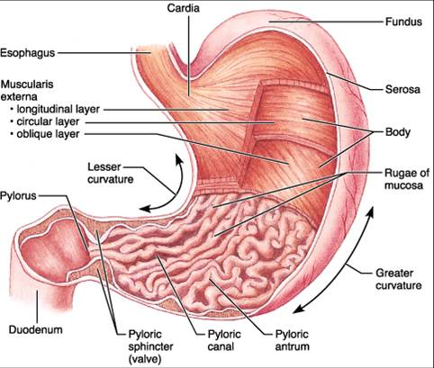
STOMACH DIAGRAM

Slide 6
FUNCTIONS OF THE STOMACH
It acts primarily as a reservior of food. It also acts as a mixer of food.
By its peristaltic movements, it softens and mixes the food with the gastric juice.
The gastric glands produce the gastric juice which contains enzymes that play an important role in digestion of food.
The gastric glands also produce hydrochloric acid which destroys many organisms present in food and drink.

Slide 7
Cont’d
The lining cells of the stomach produce abundant mucus which protects the gastric mucosa against the corrosive action of hydrochloric acid.
Some substances like alcohol, water, salt, and few drugs are absorbed in the stomach.
Stomach produces the intrinsic factor which helps in the absorption of vitamin B12.

Slide 8
SURFACE MARKING OF THE STOMACH
Cardiac orifice is at the junction between the lower end of the esophagus and stomach, and marks the level at which curvatures begin. It is most fixed and lies behind 7th costal cartilage about 2.5cm to the left of a midline on a level with T11.
Pyloric orifice is at the junction between the pyloric end of the stomach and first part of the duodenum. It is variable and 1.5 cm to the right of median plane at the lower border of L1 (TPP).
.

Slide 9
PARTS OF THE STOMACH.
Stomach can be divided into 4 regions namely:
i)Cardia: surrounds the opening of the oesophagus into stomach.
Ii)Fundus: dome shaped area above the level of cardia orifice which usually contain gas bubble, food, and fluid.
Iii)Body: largest part of the stomach which extends from cardia to angula incisura.
Iv)Pylorus: distal end of the stomach extending from angular incisura to the pyloric sphincter and is divided into pyloric canal and antrum.

Slide 10
CONTD
Other features of the stomach are :
Greater curvature: convex border of the stomach which is a point of attachment of gastrosplenic ligament & greater omentum.
Lesser curvature: concave border of the stomach which is a point of attachment of lesser omentum.
Cardia notch: place where oesophagus enters the abdomen
Angula incisura: a bend in the lesser curvature which indicates the junction between the body and pylorus of the stomach.

Slide 11
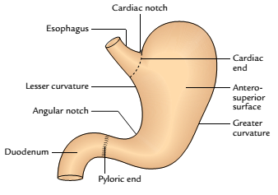
External features of the stomach

Slide 12
INTERIOR OF THE STOMACH
Gastric folds/gastric rugae: The mucosa of an empty stomach is thrown into numerous folds called gastric rugae. They are longitudinal along the lesser curvature and irregular in the remaining part. The rugae are flattened when the stomach is distended.
Gastric pits: These are small depressions on the mucosal surface in which open the gastric glands.

Slide 13
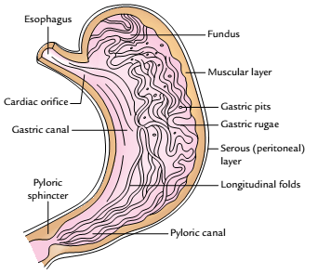
Interior of the stomach

Slide 14
Cont’d
Gastric canal: A longitudinal furrow that forms temporarily during swallowing between the longitudinal folds of the mucosa along the lesser curvature. It forms due to firm attachment of the gastric mucosa to the underlying muscular layer, which does not have an oblique layer at this site. This canal allows a rapid passage of swallowed liquids along the lesser curvature to the lower part before it spreads to the other parts of the stomach.

Slide 15
Cont’d
The lesser curvature is subject to maximum insult of the swallowed spicy food and irritable liquids (e.g., alcohol), which makes it vulnerable to the gastric ulceration.

Slide 16
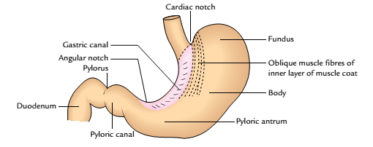
Gastric canal

Slide 17
RELATIONS OF STOMACH/STOMACH BED
Anteriorly, It related to : Left lobe of liver, diaphragm, anterior abdominal wall.
Posteriorly, It related to: Omental bursa which separates it from diaphragm above.
The Stomach bed on which it rests in supine position are:
Superiorly : Left dome of diaphragm, superior pole of left kidney, Left suprarenal gland, spleen.
Inferiorly: Body & tail of pancreas, and Transverse colon.

Slide 18
Peritoneal Relations
The stomach is covered by the peritoneum except where blood vessels run along its curvatures and a small area (called bare area of the stomach) posteriorly near the cardiac orifice.
The bare area of the stomach is directly related to the left crus of the diaphragm.
The peritoneal folds extending from the lesser and greater curvatures of the stomach to other structures.

Slide 19
Cont’d
Lesser omentum, extends from the lesser curvature of the stomach to the liver.
Greater omentum, extends from the lower two-third of the greater curvature to the transverse colon.
Gastrosplenic ligament, extends from the upper one third of the greater curvature (i.e., fundus) to the spleen (near the hilum).
Gastrophrenic ligament, extends from the uppermost part of the fundus to the diaphragm

Slide 20
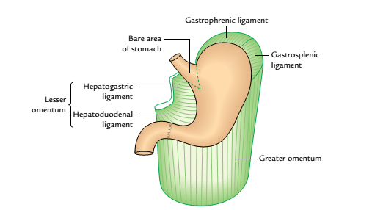
Cont’d
Peritoneal relations of the stomach

Slide 21
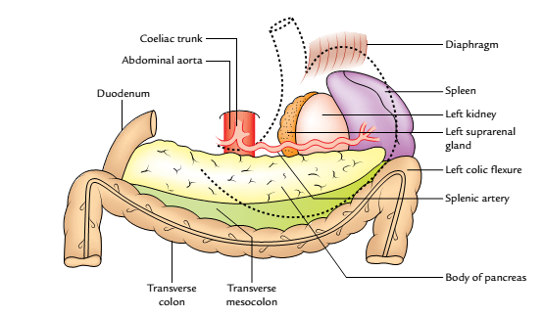
The stomach bed

Slide 22
Arterial supply
Stomach has rich arterial supply derived from 3 branches of celiac trunk viz :
i)Left gastric, (ii) Common hepatic (iii) Splenic arteries.
Both Right and left gastric arteries supply the lesser curvature.
Both Right and left gastro-epiploic arteries supply the greater curvature.
Short gastric artery supplies the fundus.
Note that the Left gastro-epiploic and short gastric arteries are from the splenic artery while Right gastro-epiploic is from gastroduodenal artery of hepatic artery.

Slide 23
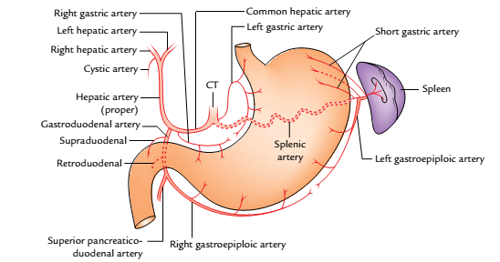
Arteries of the stomach (CT = coeliac trunk)

Slide 24
VENOUS DRAINAGE
Right and left gastric vein drain into the portal vein.
Right gastro-epiploic vein drains into superior mesenteric vein or portal vein directly.
Left gastro-epiploic and short gastric vein drains into the splenic vein which joins with the superior mesenteric vein to form “portal vein”.

Slide 25
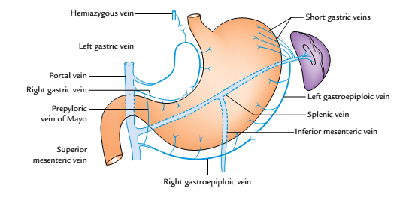
Venous drainage of the stomach

Slide 26
NERVE SUPPLY
Sympathetic Innervation
The sympathetic fibres are derived from T6 to T10 spinal segments via greater splanchnic nerves, and coeliac and hepatic plexuses. They reach the stomach by running along its arteries.
The sympathetic supply to the stomach is (a) vasomotor, (b) motor to pyloric sphincter, and inhibitory to the remaining gastric musculature, and (c) serves as the chief pathway for pain sensations from the stomach.

Slide 27
Cont’d
Parasympathetic Innervation
The parasympathetic fibres are derived directly from the vagus nerve.
The anterior vagal trunk derived largely from the left vagus nerve and partly from the right vagus nerve enters the abdomen on the anterior surface of the esophagus. Soon, after entering the abdomen, it gives off three branches in the vicinity of the lesser curvature.

Slide 28
Cont’d
Hepatic branch (or branches), which runs in the upper part of the lesser omentum to the porta hepatis to supply the liver and gallbladder. It also gives a branch to the pyloric antrum.
Coeliac branch, which follows the left gastric artery to the celiac plexus.
Gastric branch/nerve of Latarjet (largest of the three branches), which follows the lesser curvature and distributes anterior gastric branches to the stomach as far as the pylorus.

Slide 29
Cont’d
The posterior vagal trunk derived largely from the right vagus nerve and partly from the left vagus nerve enters the abdomen on the posterior surface of the esophagus; soon after entering the abdomen it also gives rise to three types of branches.
Coeliac branch to the coeliac ganglion.
Nerve of Grassi is the name given to one or more branches of the posterior vagal trunk which arises at the level of the gastroesophageal junction and supplies the gastric fundus.

Slide 30
Cont’d
Gastric branch (nerve of Latarjet) which runs along the lesser curvature and gives branches to the posterior surface of the stomach.
Vagotomy
The vagus nerves largely control the secretion of acid by the parietal cells of the stomach. Since excess acid secretion is the main cause of peptic ulcers, the section of vagal trunks (vagotomy) as they enter the abdomen is carried out to reduce the production of acid.

Slide 31
Cont’d
Vagotomy is of three types
Truncal vagotomy: In this both the vagal trunks (anterior and posterior) are sectioned at the lower end of the esophagus.
Selective vagotomy: In this, the nerves of Latarjet are selectively cut to denervate the acid and pepsin secreting area of the stomach.
Highly selective vagotomy: In this only parietal cells of the stomach are denervated by cutting the anterior and posterior gastric branches, particularly the nerve of Grassi.

Slide 32
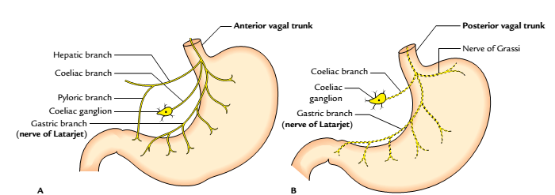
NERVE SUPPLY
Parasympathetic innervation of the stomach: A, distribution of the anterior vagal trunk;
B, distribution of the posterior vagal trunk

Slide 33
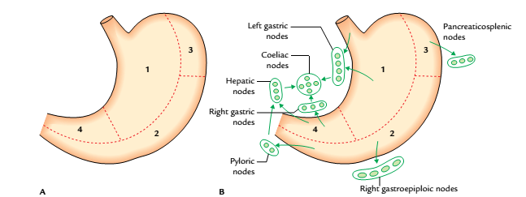
LYMPHATIC DRAINAGE
Lymphatic drainage of the stomach: A, lymphatic territories; B, lymph node groups draining the lymphatic territories of the stomach

Slide 34
Applied Anatomy
Gastric ulcer in the lesser curvature.
Gastric carcinoma (gastric cancer): It commonly occurs in the region of pyloric antrum along the greater curvature of the stomach. The cancer cells reach the left supraclavicular lymph node through the thoracic duct. It can rupture into the pancreas causing back pain which may be transmitted to splenic artery leading to “retroperitoneal haemorrhage”
Congenital hypertrophic pyloric stenosis
Pylorospasm.
Gastrectomy

Slide 35


